Slide 1
Tailored for Diversity: Adapting Garment Patterns to Fit Diverse Body Shapes
Team 10 :
Lily Bharati Sharma, Xinru Zheng, Xuran Zhang, Yuze Gu, Yanan Zhang

Slide 2
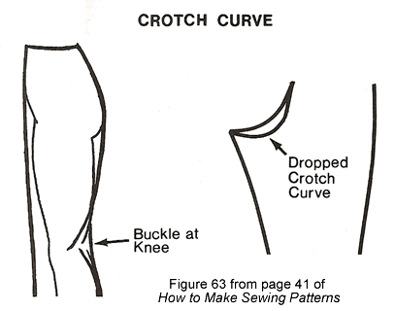
Project objective
If crotch curve features & female characteristics enhance race prediction accuracy
Examine how lower torso shapes change for each race
Enhance pants fit for all races

Slide 3
Initial Literature Review

Slide 4

Summary of Objectives in Prior Studies
Fit Problem Resolution
Crotch curve adjustments for enhancing fit
Enhancement of Trouser Pattern Construction
Techniques improve trouser pattern construction
Classification of Body Shapes for Garment Design
Classify body shapes to tailor garments

Slide 5

Statistical Techniques for Prediction
Regression Analysis
Predictive models to estimate DE distributions along crotch curves
Factor Analysis
Identify factors influencing body shapes & pattern construction
Clustering Methods
Body shapes categorized into clusters
Principal Component Analysis (PCA)
Analyze variance in body shape data & streamline pattern generation.

Slide 6

Data Collection Methods
Anthropometric Measurements
Direct measurement techniques
3D Body Scanning
Advanced technology captures precise body measurements
Facilitating accurate pattern drafting
Image-Based Shape Analysis
Parameter extraction based on images

Slide 7
Somatic factors & Pattern Drafting
Exploration of Somatic Factors and Pattern Drafting Techniques:
Crotch Curve Width Considerations
Optimal crotch curve width based on hip depth & wearer's age
Age Variations
Variations in crotch curve dimensions observed across different age groups
Measurement and Analysis Techniques
Accurate measurement & analysis of body parameters

Slide 8
Exploratory Data Analysis

Slide 9
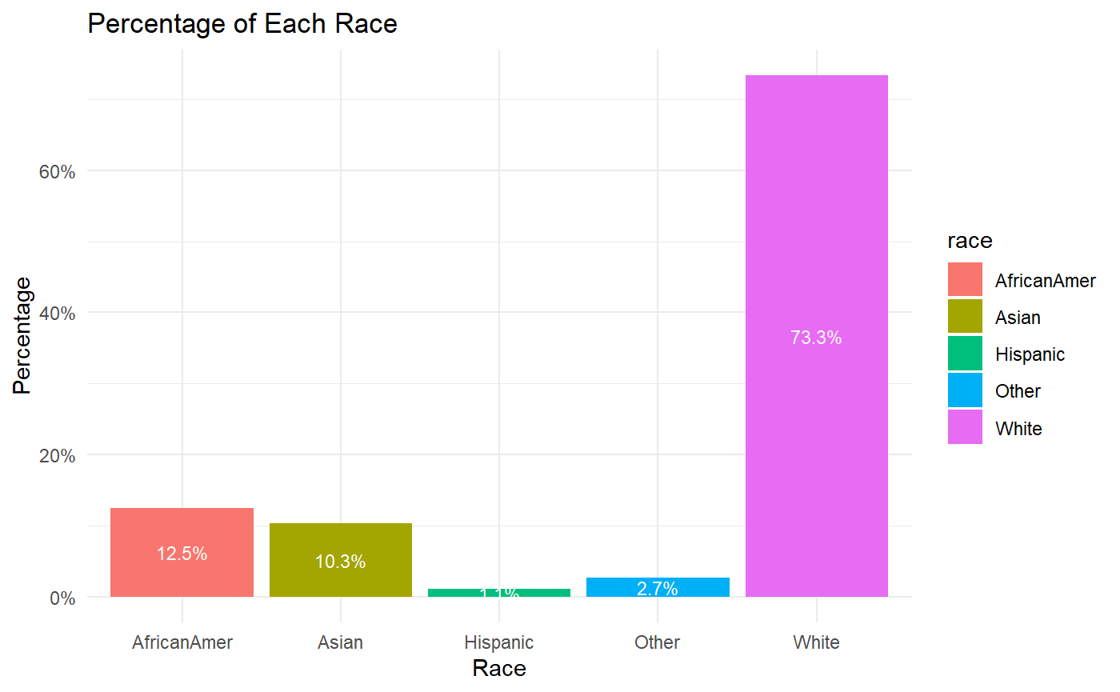
Data Overview
Total –551 subjects
White – 405
Approximately-30% of the data from all other race.

Slide 10
Detect Missing Values
Exclude the data from analysis
 | Missing
Anterior_posterior_Length | 3
Depth | 3
Crotch_curve_length_at_back_waist | 7
Front_Crotch_Left_side | 7
Back_Crotch_Right_Side | 7
Depth | 3
Crotch_curve_length_at_back_waist | 7
Front_Crotch_Left_side | 7
Back_Crotch_Right_Side | 7
These are data points which is Funky shape / bad crotch curve

Slide 11
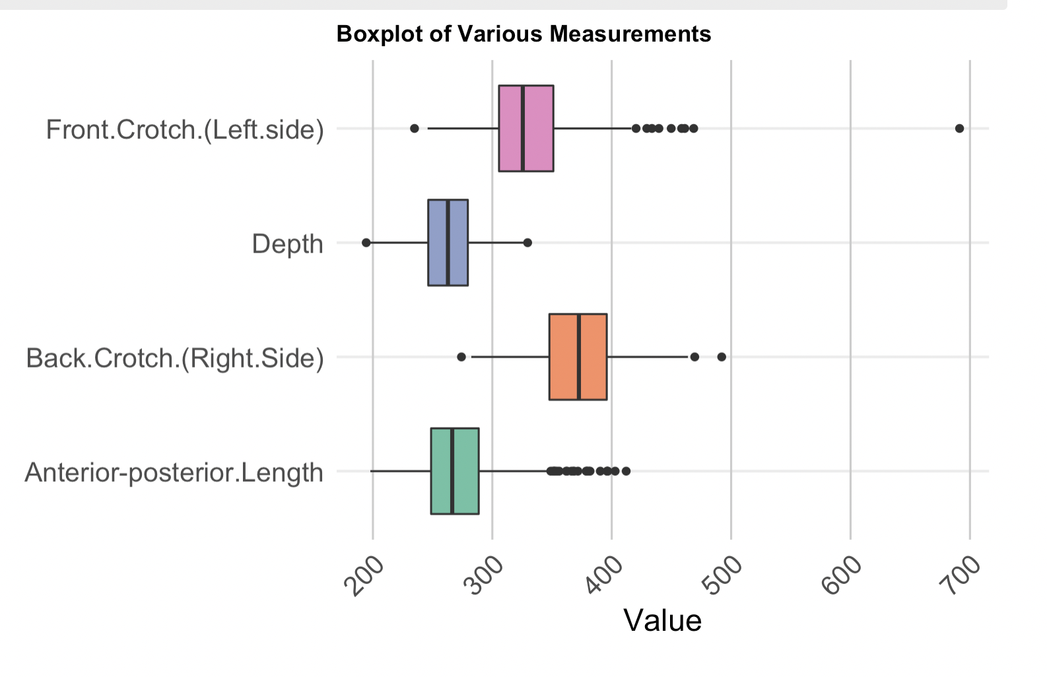
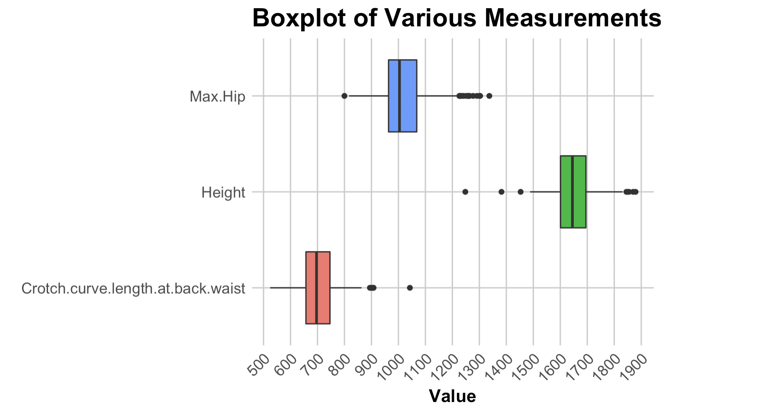
Overall Boxplot
Provide a visual summary of the distributions of distinct body measurements
In general, all variables have outliers existed.
Notes:
Front Crotch (Left side) show a number of outliers that fall outside the general spread of the rest of the data.
Depth has the smallest range
Anterior-posterior Length has outliers closely situated around the whiskers.
Height: Height has a widest range, with a few outliers at the higher end.
Followed by Max Hip: with several outliers at the upper and lower end.
Then by Crotch Curve Length at Back Waist: with some outliers higher ends.

Slide 12
Detecting Outliers
Race | AfricanAmer | Asian | Hispanic | Other | White
BMI | 2 | 1 | 1 | 0 | 20
Height | 3 | 0 | 0 | 2 | 5
Max_Hip | 1 | 1 | 0 | 0 | 13
Anterior_posterior_Length | 2 | 2 | 1 | 0 | 17
Depth | 0 | 5 | 1 | 0 | 6
Crotch_curve_length_at_back_waist | 1 | 2 | 1 | 0 | 5
Front_Crotch__Left_side | 1 | 1 | 1 | 0 | 6
Back_Crotch__Right_Side | 1 | 3 | 0 | 0 | 2
Calculate the first quartile (Q1) and third quartile (Q3) for each variable.
Determine the lower and upper bounds using the formula:
Lower Bound = Q1 - 1.5 * IQR
Upper Bound = Q3 + 1.5 * IQR
Identify values outside the bounds as outliers.
Notes:
In summary, the White group have the highest number of outliers across the majority of measurements, particularly in BMI, Max_Hip, and Anterior_posterior_Length.
iQR refers to the interquartile range, the difference between the 75th and 25th percentiles of the variable.

Slide 13
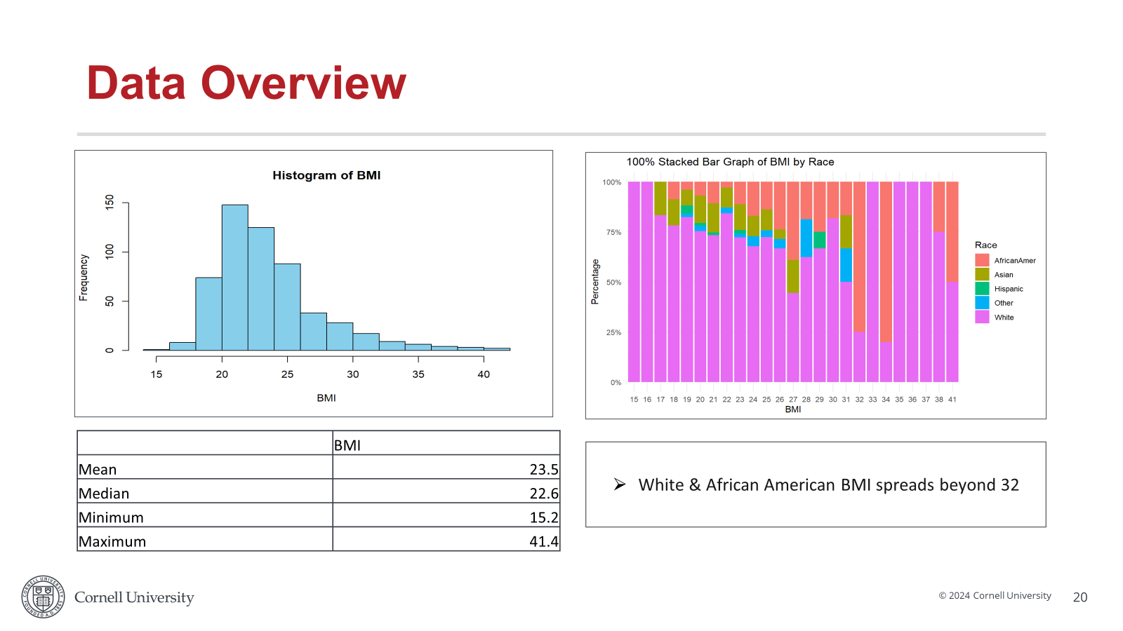
Overall Boxplot
Notes:
Both Front Crotch (Left side) and Back Crotch (Right Side) show a number of outliers that fall outside the general spread of the rest of the data.
The measurement of the Anterior-posterior Length has the relatively small variation, with the box being very compact and outliers closely situated around the whiskers.

Slide 14
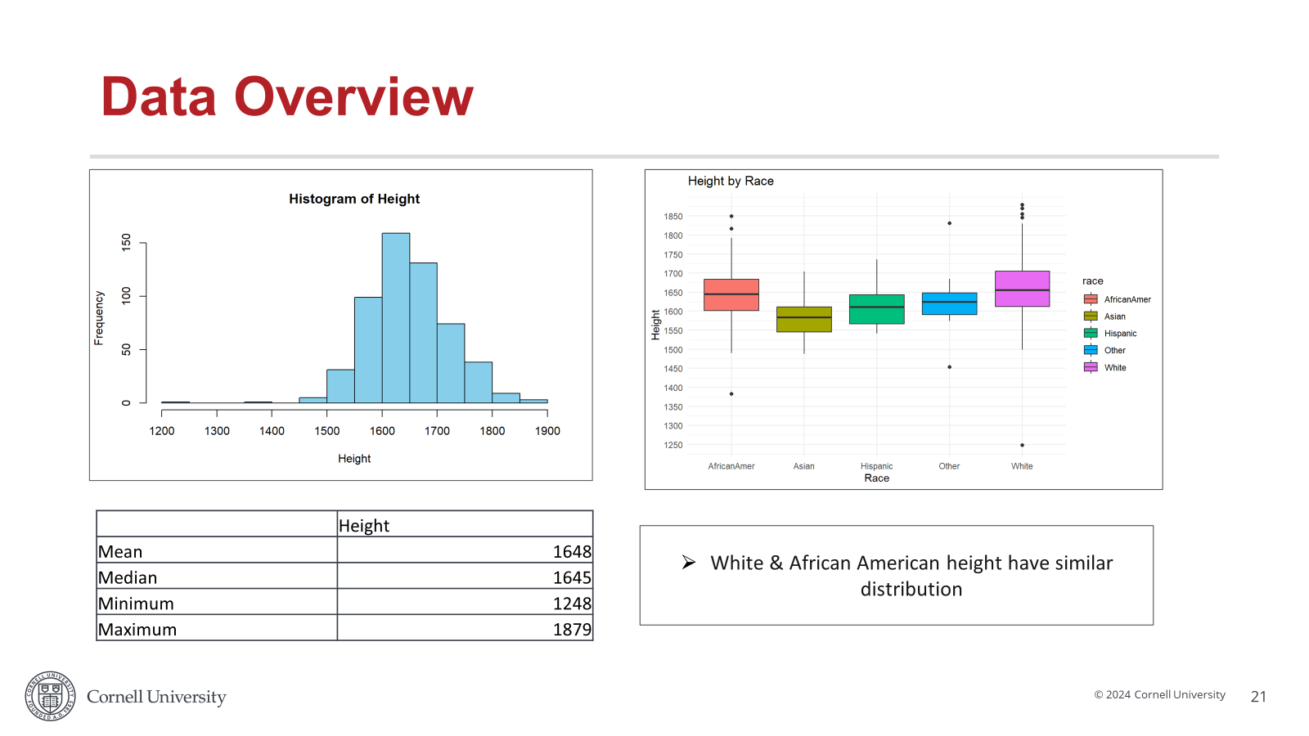
Overall Boxplot
Notes:
Both Front Crotch (Left side) and Back Crotch (Right Side) show a number of outliers that fall outside the general spread of the rest of the data.
The measurement of the Anterior-posterior Length has the relatively small variation, with the box being very compact and outliers closely situated around the whiskers.

Slide 15
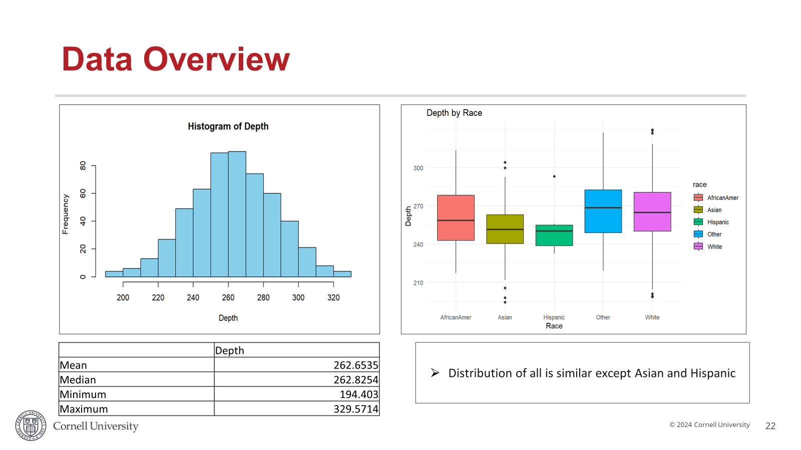
Overall Boxplot
Notes:
Both Front Crotch (Left side) and Back Crotch (Right Side) show a number of outliers that fall outside the general spread of the rest of the data.
The measurement of the Anterior-posterior Length has the relatively small variation, with the box being very compact and outliers closely situated around the whiskers.

Slide 16
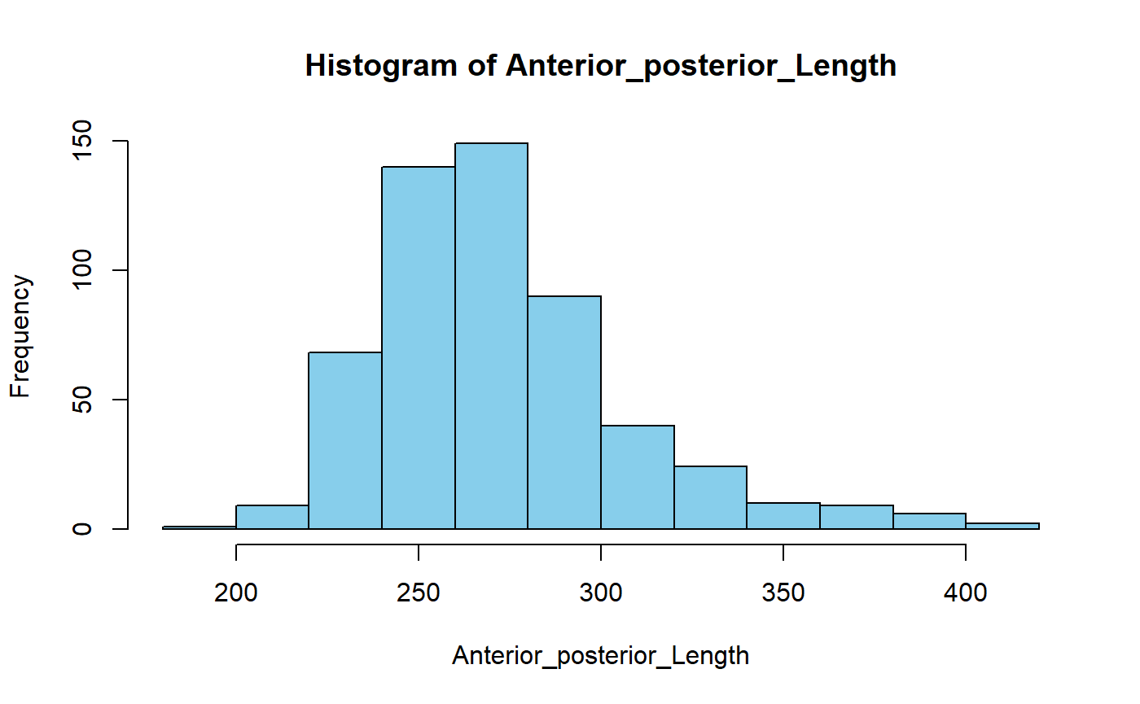
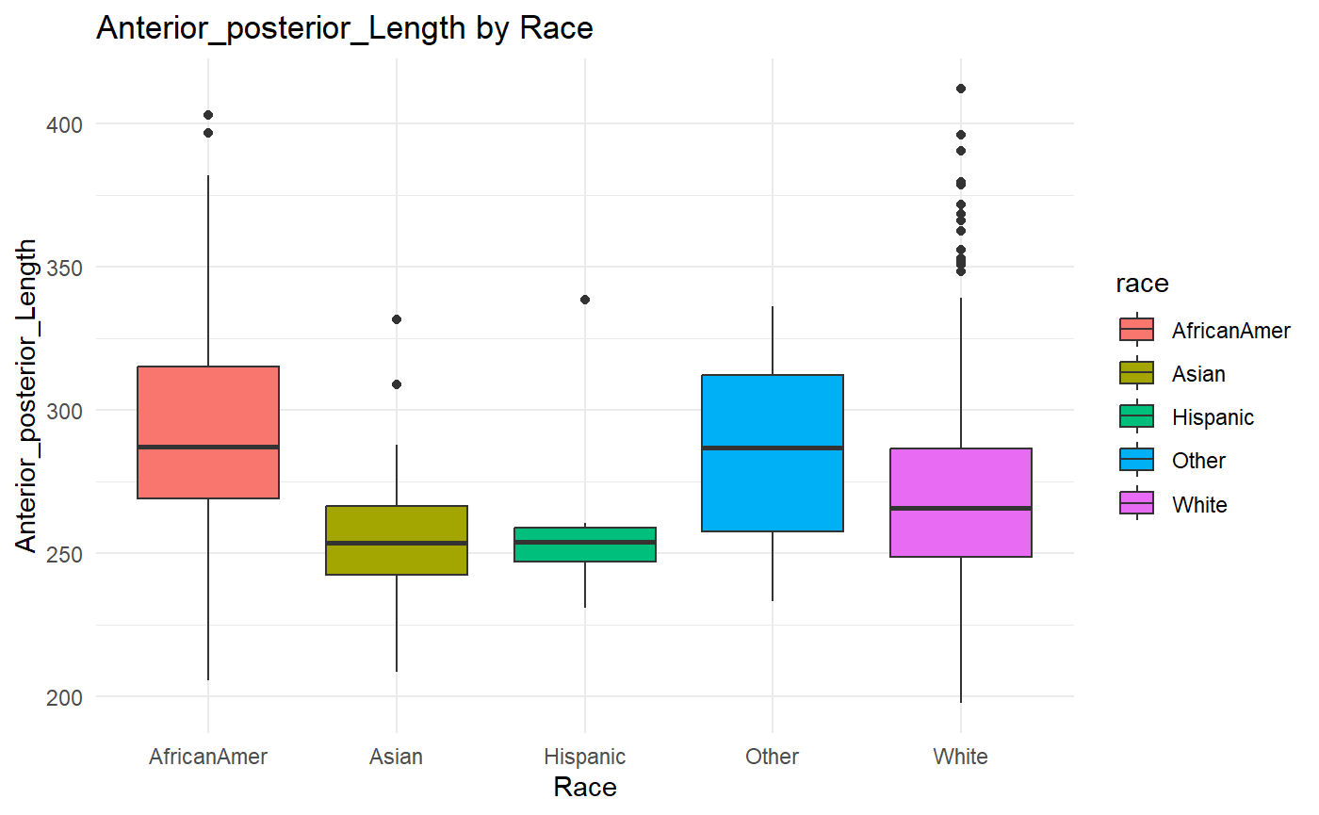
Data Overview
 | Anterior_posterior_Length
Mean | 272.8103
Median | 266.4087
Minimum | 197.836
Maximum | 412.0992
Other & African American Anterior posterior length have similar distribution

Slide 17
ANOVA Results
Three ethnic groups: White, African American, Others
Conducted ANOVA tests on all quantitative variables
Concluded significant differences
Between means of variables across different ethnic groups
Notes:
To find whether the means of these groups are different

Slide 18
ANOVA Results
Three ethnic groups: White, African American, Others , ANOVA tests was conducted on all quantitative variables to understand segmentation by race
Variable name | F-statistic | P-value
BMI | 15.34 | 3.29e-07
Height | 29.99 | 4.38e-13
Depth | 6.929 | 0.00107
Front.Crotch.(Left.side) | 6.559 | 0.00153
Back.Crotch.(Right.Side) | 9.463 | 9.13e-05
Max.Hip | 23.12 | 2.29e-10
Crotch.curve.length.at.back.waist | 9.502 | 8.79e-05
Anterior-posterior.Length | 18.94 | 1.12e-08
Conclusion: differences between means of variables across different ethnic groups
Need to segment White and American-African race separately

Slide 19
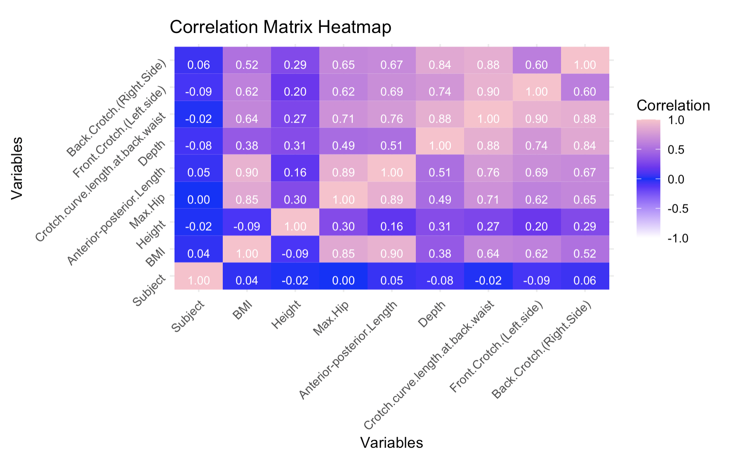
Correlation Graph
Positive correlation:
BMI v.s Anterior-posterior Length (0.9)
Front.Crotch.(Left.side) v.s Crotch.curve.length.at.back.waist (0.9)
Anterior-posterior length v.s Max.Hip (0.89)
Depth v.s Crotch.curve.length.at.back.waist (0.88)
Negative correlation:
BMI v.s Height (-0.9)
Notes:
There is a strong correlation between "Crotch.curve.length.at.back.waist" and "Front.Crotch.(Left.side)" (approximately 0.9), suggesting that changes in one of these crotch length measurements are likely to be accompanied by changes in the other
"Anterior-posterior.Length" has a very high correlation with BMI (approximately 0.9), indicating that as BMI increases, the Anterior-posterior Length also tends to increase, which might be useful for health and fitness assessments.
A negative correlation of -0.9 between BMI vs. height suggests a very strong inverse relationship between the two variables. This means that as height increases, BMI tends to decrease significantly, and vice versa. (Reason why above have a negative correlation, Tall individuals may have lower BMI: Since BMI is calculated as weight divided by the square of height, taller individuals might have a lower BMI if their weight does not increase proportionally with their height.)
Depth vs. Crotch Curve Length at Back Waist (0.88 correlation coefficient): individuals who have a greater depth measurement tend to have longer measurements for the curve length at the back of the waist's crotch area.
Anterior-posterior Length vs. Max-Hip (0.89 correlation coefficient):. A strong correlation of 0.89 suggests that individuals with a larger anterior-posterior length will have a larger hip circumference, indicating that as the body depth (front-to-back) increases, the hip size also tends to increase proportionally.

Slide 20
Graph Fitting

Slide 21
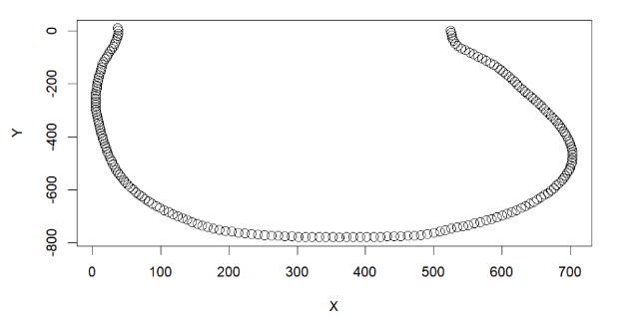
Fitting sample graph
Crotch curve of one data point
Notes:
We are given data of the coordinates of points that form the curves

Slide 22
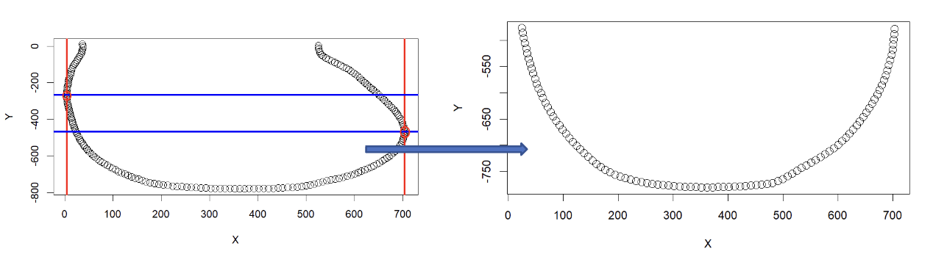
Fitting sample graph - Step 1
Separate the lower part of the graph
Notes:
Separated the lower part of the graph. Selected the left most and right most points of the curve. Select the point where the y-values are relatively low. Then, draw a horizontal line through this point to obtain the lower part.

Slide 23
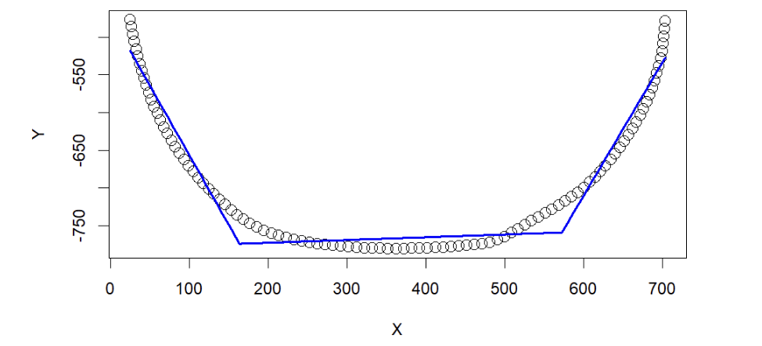
Fitting sample graph - Step 1
Use the Segmented package in R to automatically find the 2 knots

Slide 24
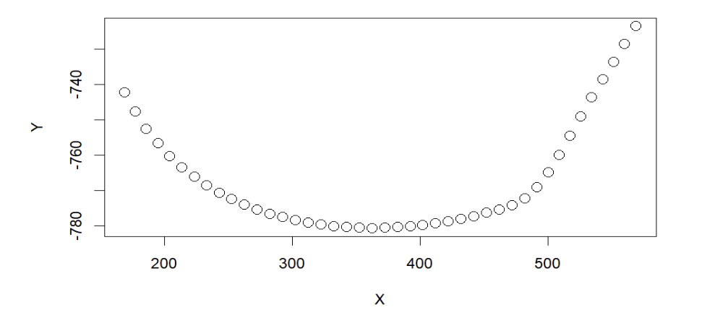
Fitting sample graph - Step 2
The middle part separated from the lower graph to estimate separately
Notes:
The middle part of the curve was separated from the lower graph to estimate it separately

Slide 25
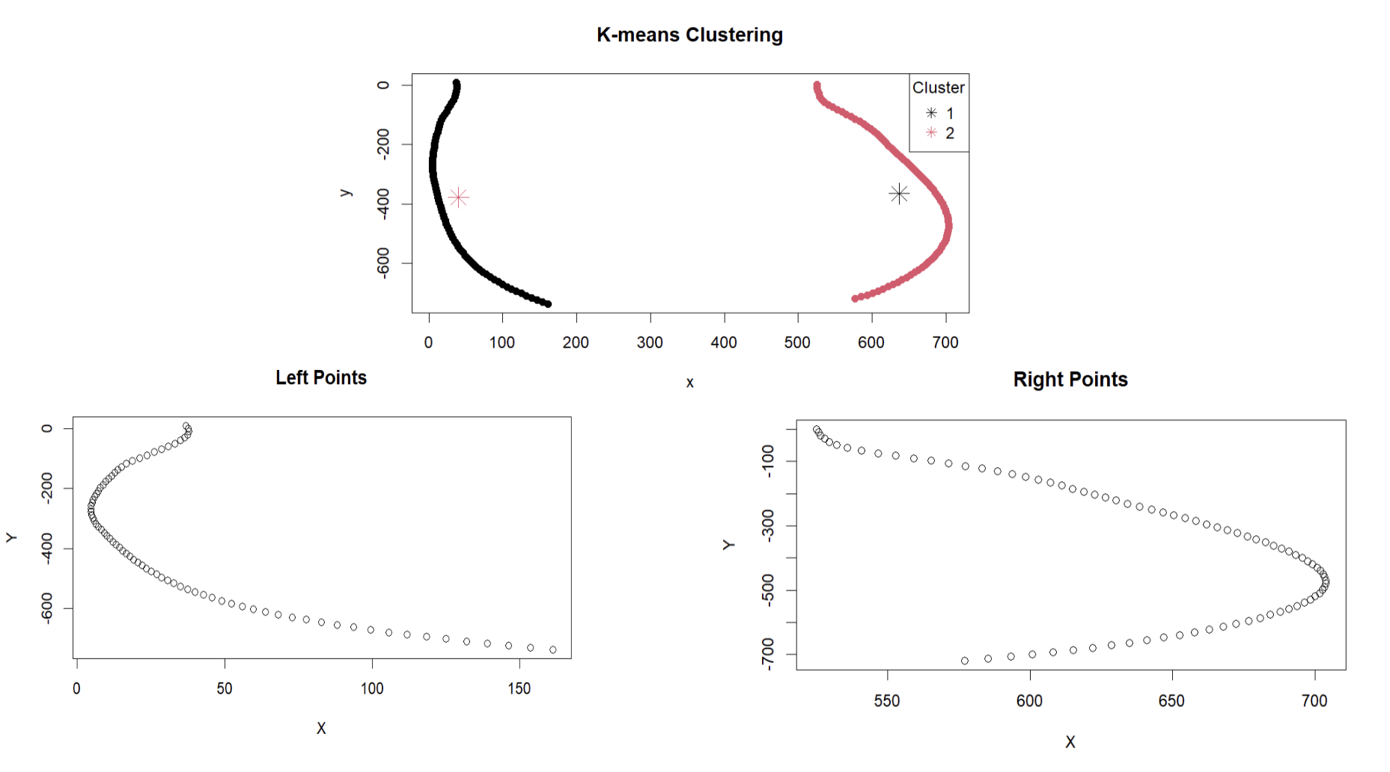
Fitting sample graph - Step 2
K-means to separate the left and right data points
Notes:
Used K-means to separate the left and right data points from the above graph

Slide 26
Fitting sample graph - Step 3
Fit the left part of the data with a third-order polynomial model
Fit the right part of the data with a third-order polynomial model
Fit the middle part of the data with a second-order polynomial model

Slide 27
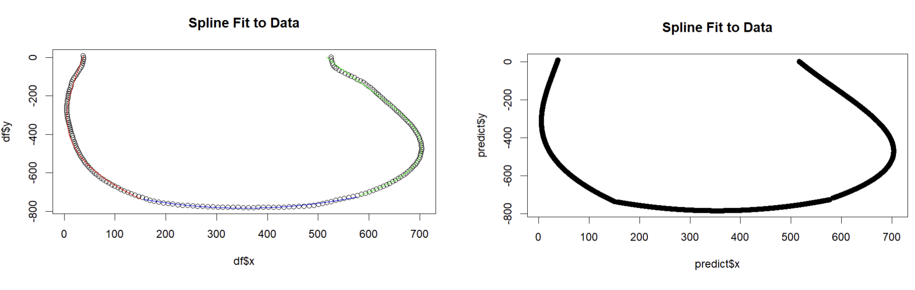
Fitting sample graph - Step 3
Plot the fitted graph
Notes:
AS the graph indicates...

Slide 28
MANOVA Test
To check if the spline coefficient estimated for crotch curves are significantly different across race
Data | Race | P-value
Left Coefficient | AfricanAmer vs Asian | 0.007066
 | Asian vs White | 0.001366
Middle Coefficient | AfricanAmer vs Asian | 2.97E-06
 | AficanAmer vs White | 3.74E-05
 | Asian vs White | 0.001365
Right Coefficient | AfricanAmer vs Asian | 0.00127
 | AfricanAmer vs White | 8.28E-07
 | Asian vs White | 0.04478
Spline Coefficients | Race | <2.2e-16
Null Hypothesis:
There are no differences in the vector of means of the body measurements (Left_I, Left_D1, Left_D2, Left_D3, Mid_I, Mid_D1, Mid_D2, Right_I, Right_D1, Right_D2, Right_D3) across the different races.
Alternative Hypothesis:
There are differences in the vector of means of the body measurements (Left_I, Left_D1, Left_D2, Left_D3, Mid_I, Mid_D1, Mid_D2, Right_I, Right_D1, Right_D2, Right_D3) across the different races.
Notes:
For spline coefficient, conclusion: There are statistically significant differences in the multivariate means of left, right and middle coefficient across the different racial groups. In other words, the race has a significant effect on the body measurements.
Next step to identify which specific race groups differ from each other
Conclusion:
For middle and right coefficient, there are statistically significant differences in body measurements btw AfricanAmer vs Asian as well as Asian vs White, AfricanAmer vs White.
For the left coefficient, there are statistically significant differences in body measurements btw AfricanAmer vs Asian and Asian vs. White.
**note: exclude other and hispanic in race

Slide 29
Machine learning Model -Predicting Race

Slide 30
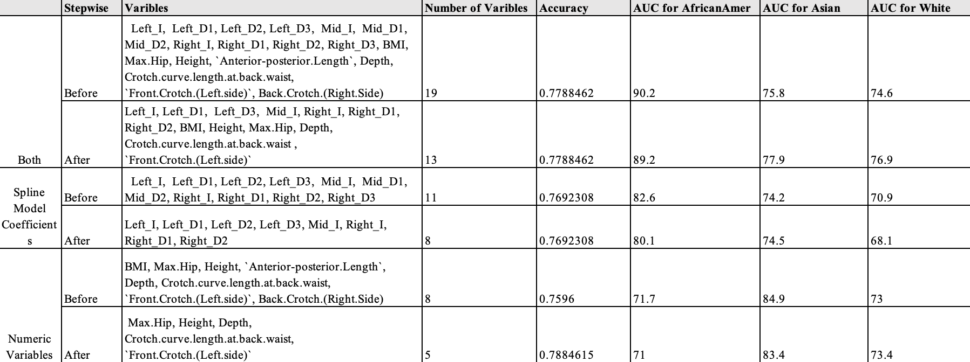
Logistic Regression
Performance metrics of Logistic regression to predict race based on various combination of input data

Slide 31
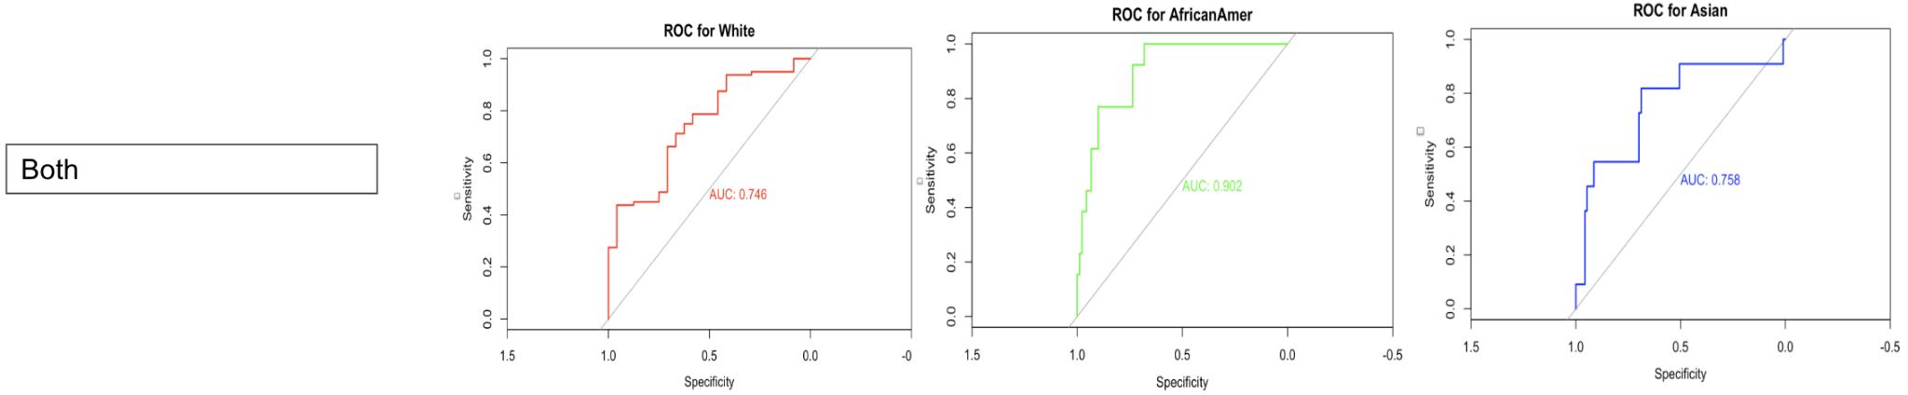
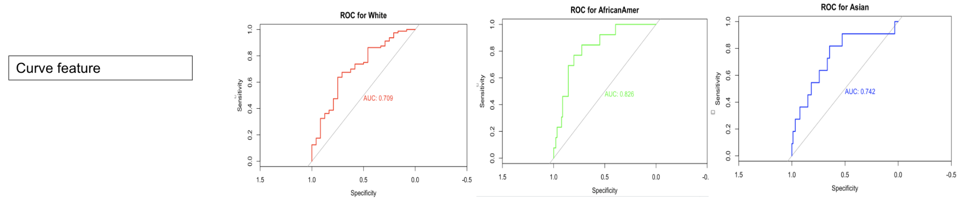
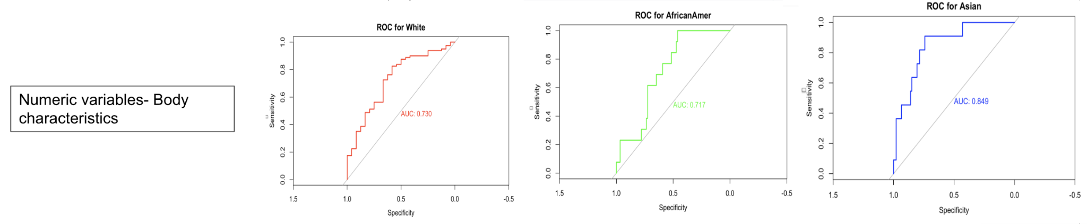
ROC Curve of Logistic Regression

Slide 32
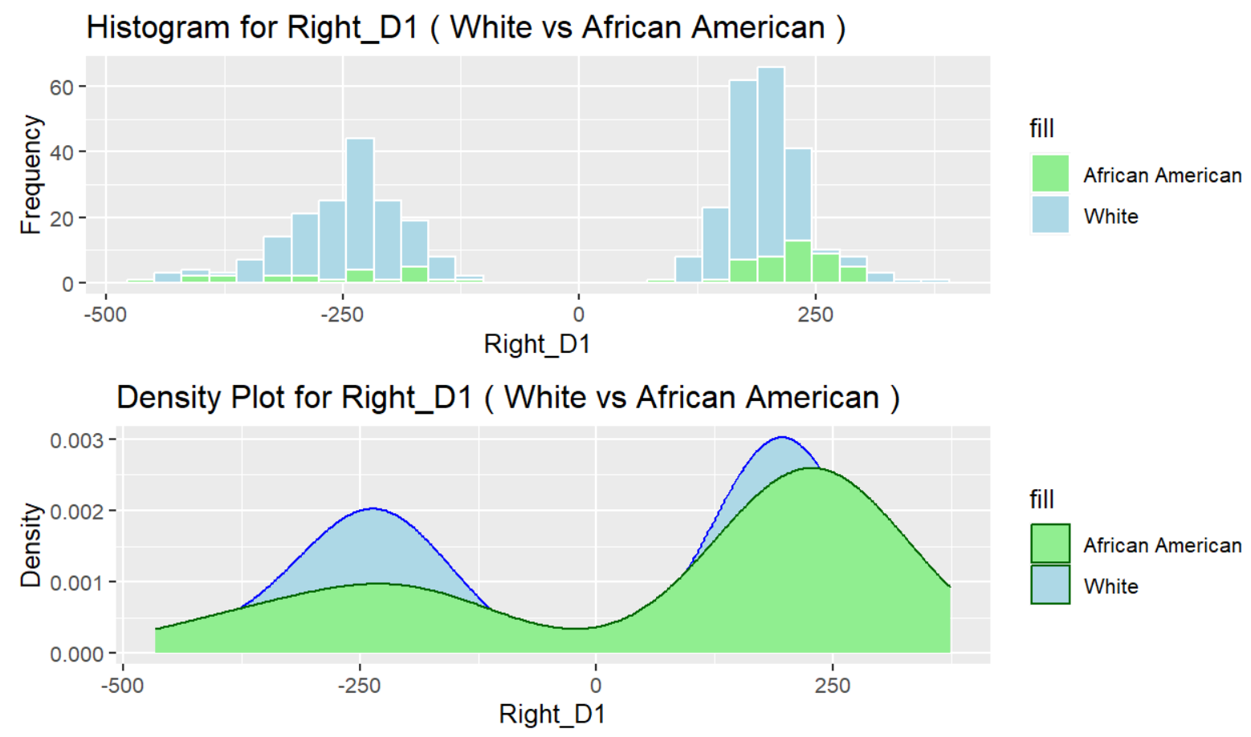
Variation in White data
We noticed even though our data has majority from White race, the Machine Learning models were unable to perform well for this group
Further analysis showed, the data within White group had a lot of variation

Slide 33
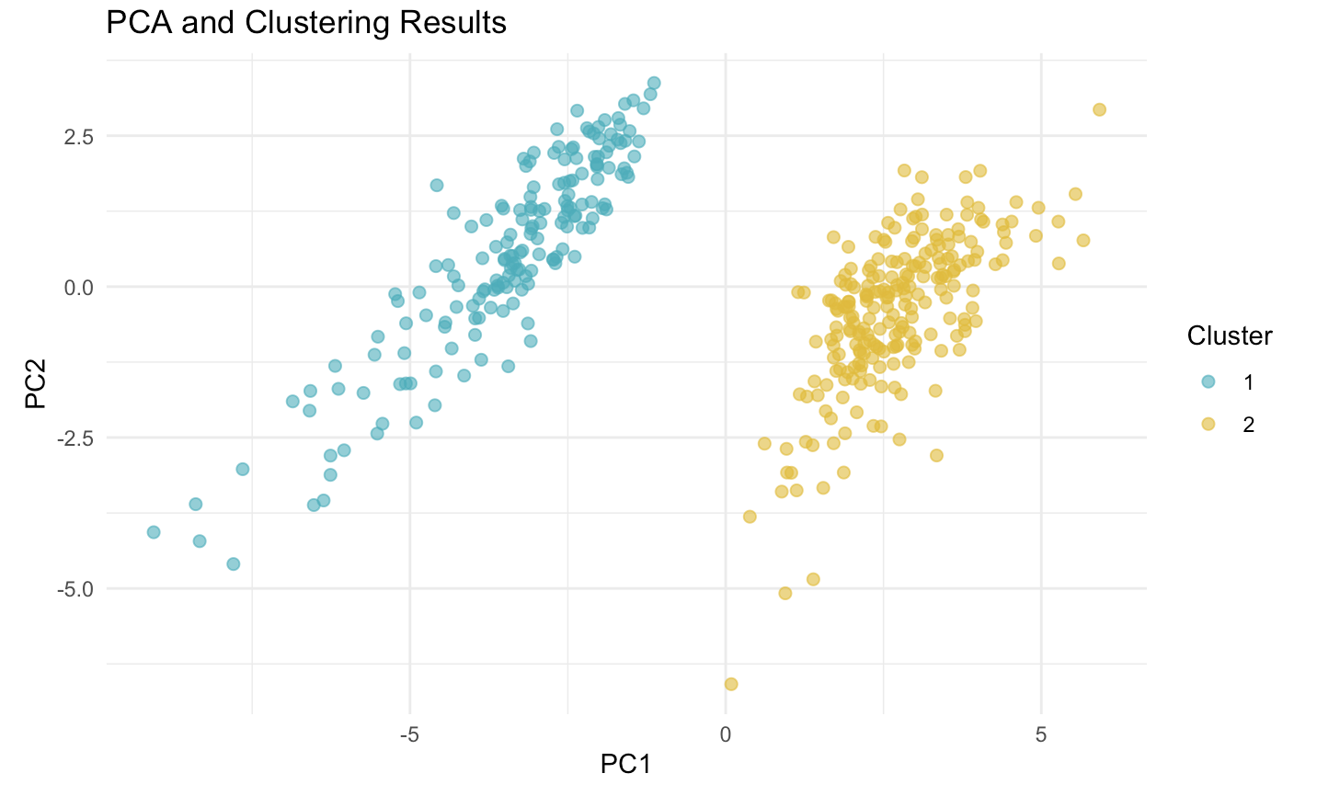
Cluster Analysis
Reduce the influence of vary data distribution in White
Balancing White and not White data amount
Balance | Accuracy | AUC for White | AUC for African Amer | AUC for Asian
Before | 0.7788462 | 74.6 | 90.2 | 75.8
After | 0.8409091 | 89.8 | 84.4 | 96.1

Slide 34
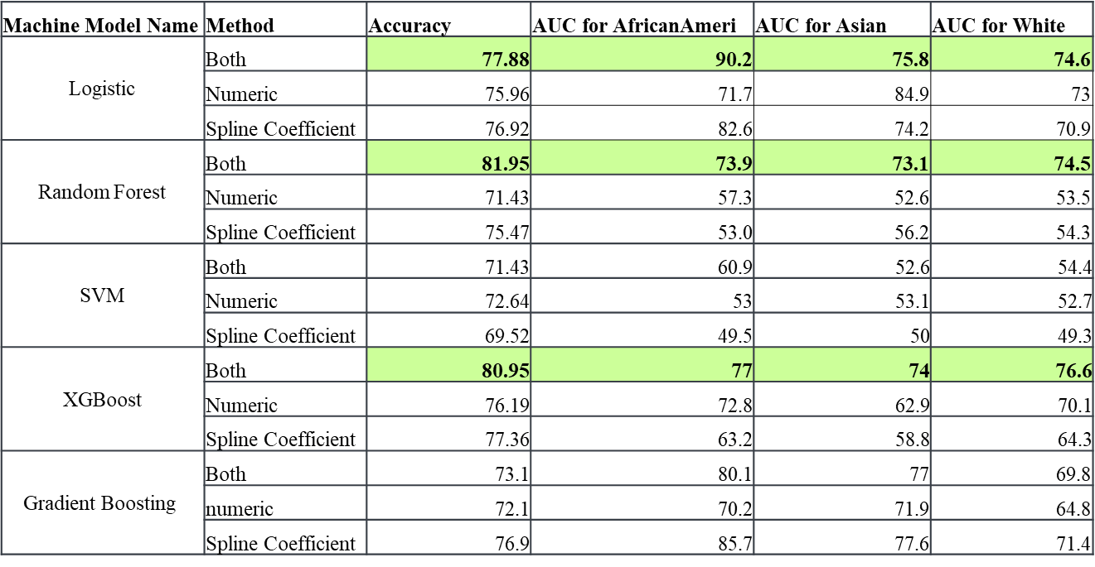
Machine Learning Model Prediction

Slide 35
Conclusions & Takeaways
Adding curve features along with numeric variables
Improve model prediction
Enhance race prediction accuracy
Potential improvement for future pants fit for everyone

Slide 36
Acknowledgements/Special Thanks
Client: Professor Fatma Baytar
Advisor: Professor Sreyoshi Das
Consultant: Professor Sumanta Basu

Slide 37
Appendix

Slide 38
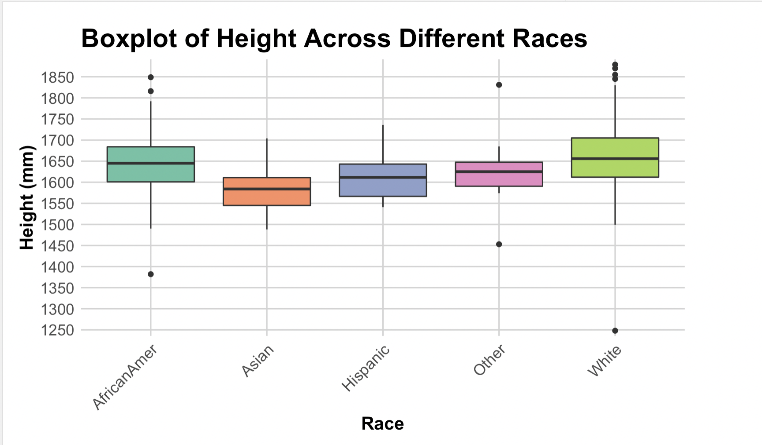
Boxplot of Race vs Height
Notes:
The median height for the African American group is the highest among the groups, with a relatively narrow interquartile range (IQR), indicating less variability in height within this group.
Asian individuals show the lowest median height, with a compact IQR but a wider range of outliers, both low and high.
All groups show some presence of outliers, indicating that there are individuals whose heights are considerably different from the central tendency of their respective groups.

Slide 39
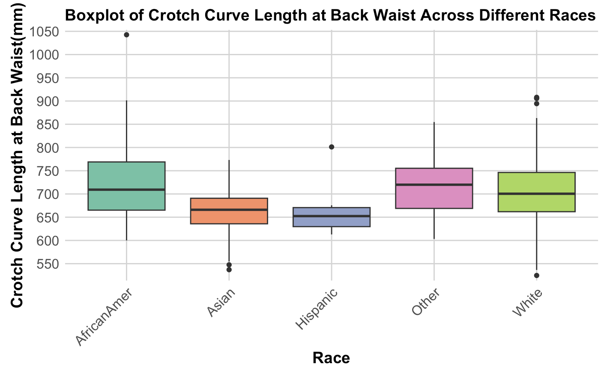
Boxplot of Race vs Crotch Curve Length at Back Waist
Notes:
African American individuals display the widest interquartile range (IQR), indicating greater variability within this group.
Asian individuals have the smallest IQR, suggesting less variability in crotch curve length within this group.

Slide 40
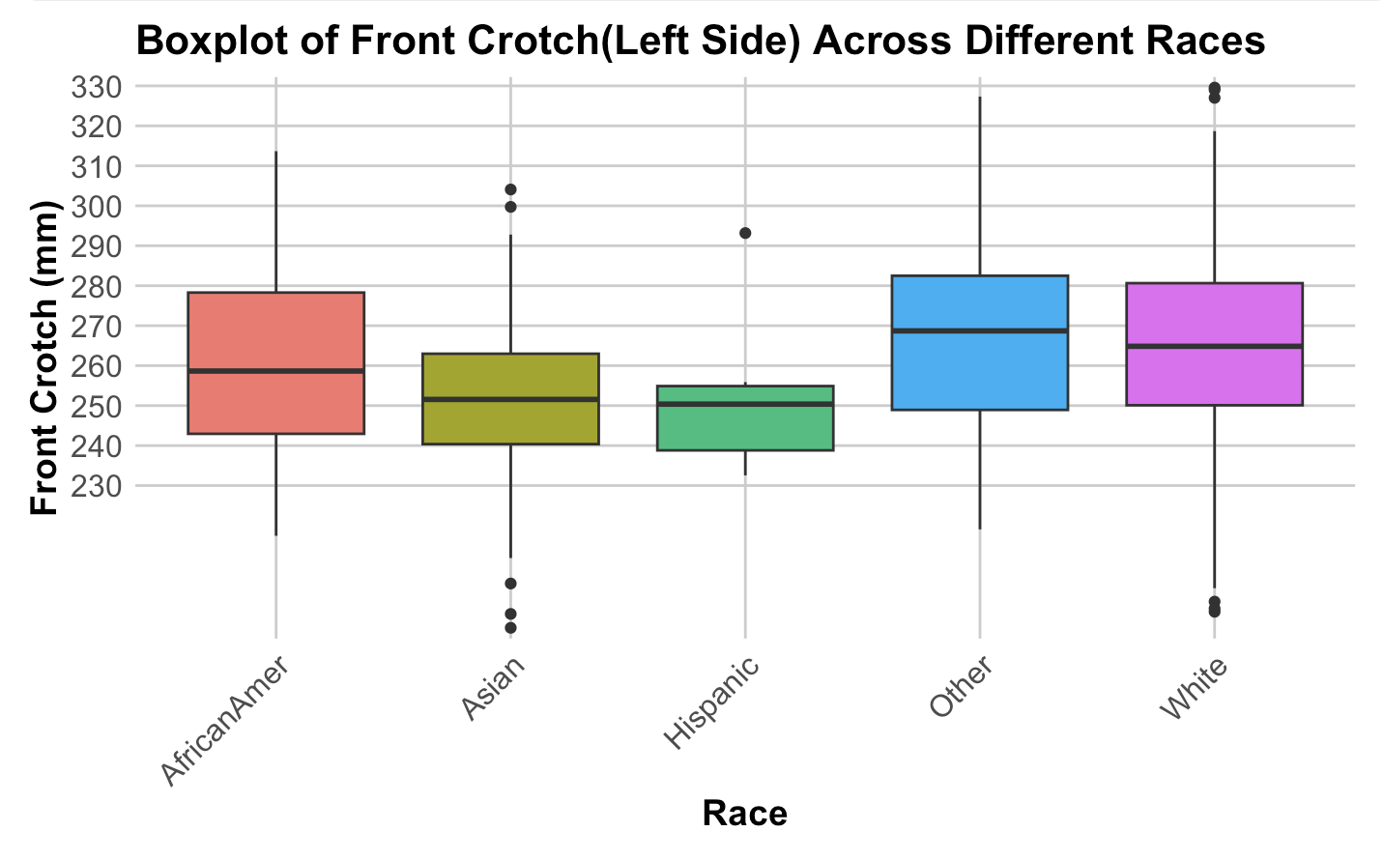
Boxplot of Race vs Front Crotch(Left Side)
Notes:
African American group has the highest median measurement, with a relatively wide interquartile range (IQR), indicating variability within this group. It also has a few outliers on the lower end.
Asian group's box is quite compact with the lowest median, suggesting less variability and consistently lower measurements in this category compared to the others.
Hispanic group has a narrow IQR similar to the Asian group, with its median being slightly higher than that of the Asian group.
The 'Other' category has a median that is higher than the Hispanic and Asian groups, with a wider IQR, indicating more variability within this group.

